Slide 1
Basic Arduino
By Chuck Duey
Sept 11th 2019

Slide 2
Think About the Scope of Your Project
Many projects try to reach too far. Start simple and improve over the semester.
This a little ahead on what might be wanted. For example, it is easier to get a board with WiFi than add it later.
Does your project need analog I/O? Some systems have it built in, other need addon boards.
Hardware is only part of the picture; most projects need more time to write and debug the software.
When possible have two of any critical hardware piece. At the last minute, hardware breaks or gets damage.
Do not procrastinate!

Slide 3
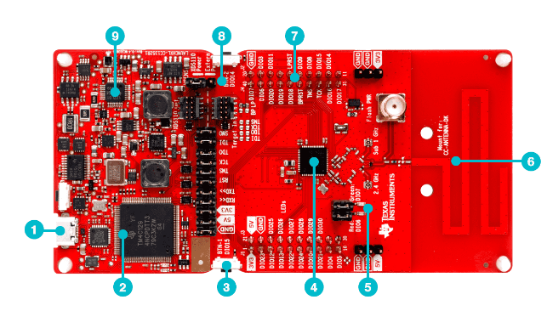
Standalone Microprocessor
Advantages
Targeted size and function. Right for the job.
Low cost.
Many EVM’s for low cost.
Support from the manufacturer.
Full custom design. Can make very small.
Disadvantages
Need to build circuitry.
Not much Open-source hardware or software
Need to pay for high level language cross compilers.
TI LaunchPad™ Development Kit

Slide 4
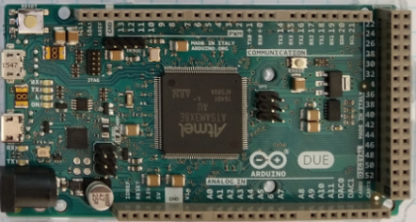
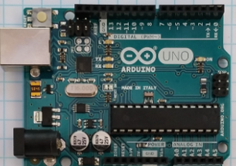
Arduino
Advantages
Many different I/O’s built in including ADC.
Very nice IDE. (Integrated Development Environment)
Huge opensource community for both hardware and software.
Many premade shields and hardware addons.
Disadvantages
ADC lower resolution and slow. Difficult to do audio speeds.
Need to get a WiFi/BT version in advance, or add on for IOT
Not a platform that can be taken directly to market.

Slide 5
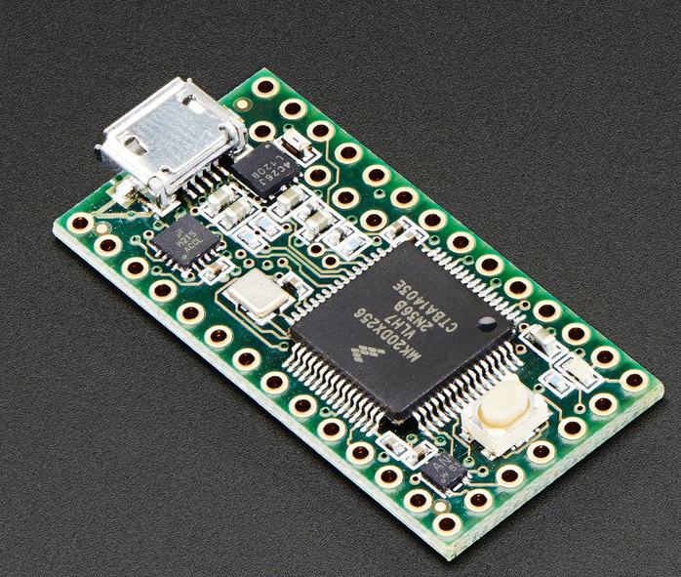
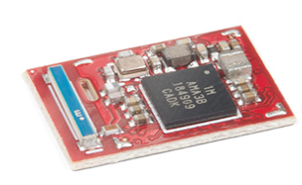
Teensy and Other Small Variants
Arduino like IDE and programming.
Many with Analog I/O.
Very small and low power.
More difficult to prototype with.
ADC lower resolution and slow. Difficult to do audio speeds.
Need to get a WiFi/BT version in advance, or add on for IOT
Teensy 3.2
SparkFun Artemis

Slide 6
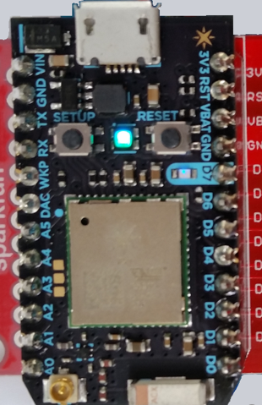
Particle Photon
Advantages
Very small and low power
Uses Arduino like IDE and language.
Is a WiFi device. Very easy to make IoT device.
Full custom design. Can make very small.
Disadvantages
Can only program over the internet.
One processor size and speed 120MHz.
Difficult to connect up dynamically to the internet.
Must have internet connection to start. (use WiFi Hotspot)

Slide 7
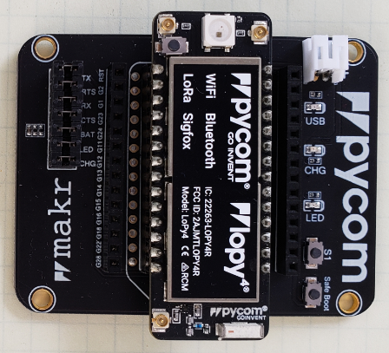
PyCom Boards
Advantages
Very small and low power
Multiple IO 8 X 12 Bit ADC 2x I2C, 2x UART, SPI, GPIO
uPython environment using Atom IDE
Built in AES,DES, and SHA/MD5 Hash
Is Multi standard wireless connections.
Antenna connections for long range
Standalone modules available.
Disadvantages
No Operating system difficult to multi task
One processor size and speed 600MIPS.
Need adapter board to program and connect to I/O.
Difficult to set up dynamic webpages.

Slide 8
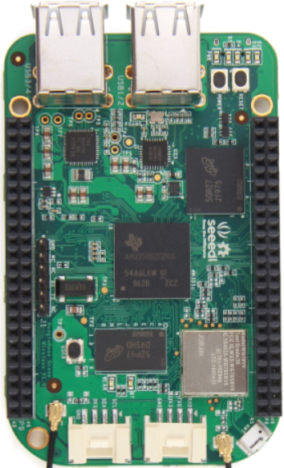
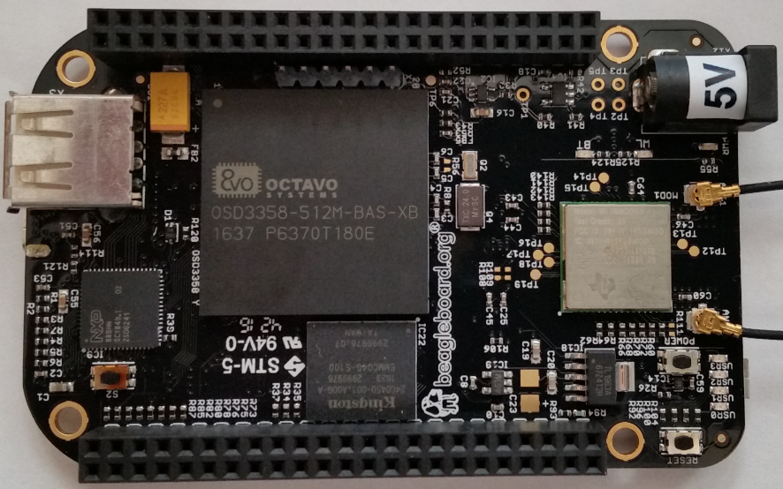
BeagleBone
Advantages
Linux operating system. Can program in many languages and interact with the internet.
Can make Webpages and run full LAMP stack.
Open source software and hardware support.
Fast ARM core processor.
The Black Version has a micro HDMI display.
Analog inputs!
Disadvantages
Display resolution not that good.
Single Core ARM Processors.
Operating system overhead.
Costs more than Raspberry Pi
Community support is not as wide as Raspberry Pi
Operating system and Overlays not stable.

Slide 9
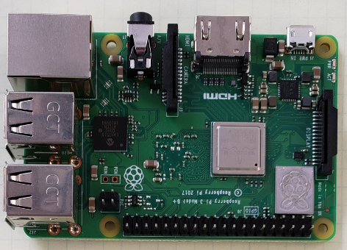
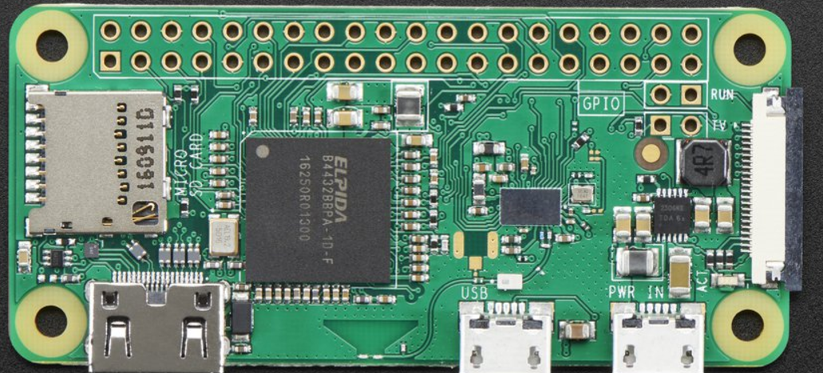
Raspberry Pi
Advantages
Linux operating system. Can program in many languages and interact with the internet.
Can make Webpages and run full LAMP stack.
Massive open source software and hardware support.
Very fast ARM core processor.
Easy to implement GUI’s for interactive programs.
Disadvantages
Need to add on hardware for Analog inputs.
Power hungry when compared to other micro controllers.
Operating system overhead.

Slide 10



For More Maker Board Information
https://media.digikey.com/Resources/Maker/the-original-guide-to-boards-2019.pdf

Slide 11
Common IC Interfaces
I2C – 100KHz/400KHz serial interface. Up to 125 devices on the same serial bus.
SPI – 20MHz and above serial interface. Uses chip select for device selection. Low device count but high speed.
Serial – RS232 most common serial device communication. Very good for higher level devices.
Parallel – One data bit per line, high speed, but very simple to implement.

Slide 12
I2C Low speed I/O
Digital Potentiometers
Oscillators
DACs
Temperature Sensors
EEPROMS
I/O Expanders
PWM Outputs
ADCs
Battery Chargers
Pressure Sensors
Control lines are open drain with pull up.
SCL - Serial Clock Line
SDA – Serial Data
Note I2S – is a serial stream digital audio standard

Slide 13
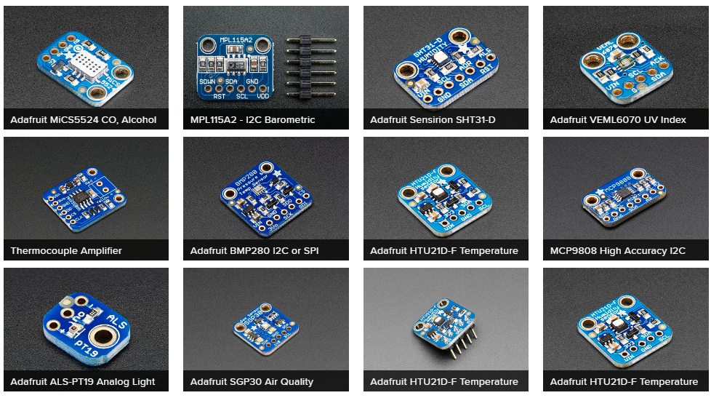
Some I2C Sensors from Adafruit

Slide 14
SPI Higher Speed I/O
Fast ADC’s
Fast DAC’s
LCD Displays
RF Transceivers
Audio Codecs
Common signals
MISO – Master Input to Slave Output
MOSI – Master Output to Slave Input
SCLK – Serial Clock
CS – Chip Select

Slide 15
Parallel
Serial
RS232 is a serial standard that has been around since the 1960’s and is still used today.
One of the most common uses is for GPS. There are many GPS modules that output NMEA9600 format.
There are many devices that still use this including some industrial controls.
While the parallel port has gone out of use, there are still some devices with parallel data out. This can provide simple high-speed data.

Slide 16
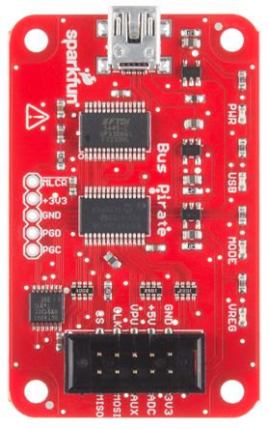
Bus Pirate – tool for serial I/O
Supported protocols:
1-Wire
I²C
SPI
JTAG
Asynchronous serial
MIDI
PC keyboard
HD44780 LCD
2- and 3-wire libraries with bitwise pin control
Scriptable binary bitbang, 1-Wire, I²C, SPI, and UART modes

Slide 17

Arduino Resources
Good Links and web sites:
www.arduino.cc – Arduino tutorials, software, and resources.
www.sparkfun.com — Brought Arduino to the US. Excelent Tutorials
www.adafruit.com — Adafruit very good site for parts and tutorials
www.digikey.com —Low priced Raspberry Pi Parts
www.microcenter.com —Online and In Store Arduino and parts
www.instructables.com/howto/Arduino/ Lots of good Arduino Tutorials
github.com/Chuckduey/CSU_Pi_Class.git GitHub page with the code from this class.
My email cduey@msn.com

Slide 18
What is an Arduino? An open source learning tool.
Arduino was started in 2003 at Interaction Design Institute Ivrea (IDII). Developed as “Wiring” project as an easy tool for fast prototyping, aimed at students without a background in electronics and programming.
Most Arduino boards use an Atmel 8-bit AVR Microcontroller. The standard boards have female connectors used with addon modules called shields.
It is an open source software and hardware environment.
* From www.ardunio.cc website

Slide 19
Some Arduino Boards
Uno – 16MHz ATmega328P, 6 Analog in, 14 GPIO
Mega2560 – 16MHz ATmega2560, 16 analog in, 54 GPIO
Due – 84MHz ATSAMD21G18, 12 analog in, 2 analog out, 54 GPIO
Leonardo – 16MHz ATmega32u4, 12 analog in, 20 GPIO, 7 PWM, 32K
Adafruit Gemma – 8MHz ATtiny85, 1 analog in 3 GPIO
Adafruit Feather – 8MHz ATmega32u4 10 analog in, 20 GPIO
Adafruit Circuit Playground – 8MHz ATmega32u4 4 analog in, 8 GPIO, Many sensor via I2C – 3 axis accelerometer, Temp sensor, light sensor, microphone, speaker, 2 push buttons and slide switch/

Slide 20
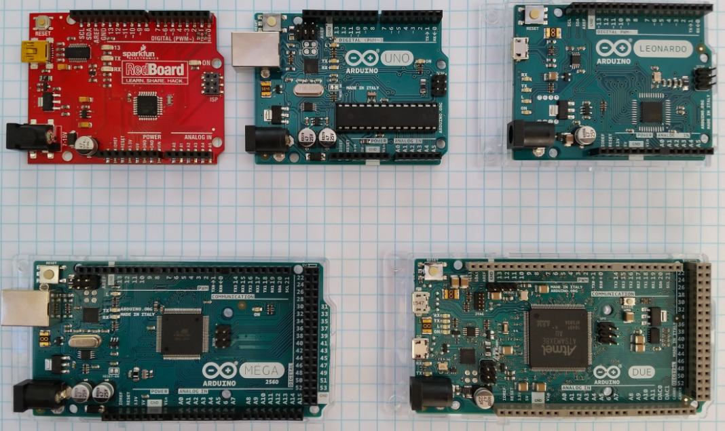
Standard Arduino Format Boards

Slide 21
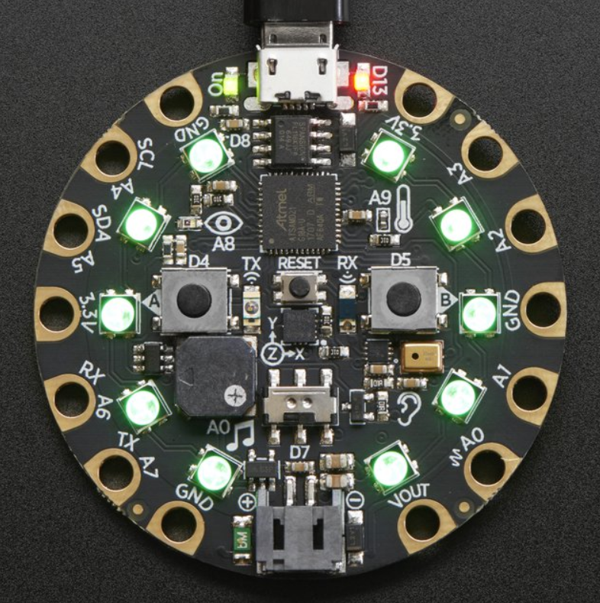
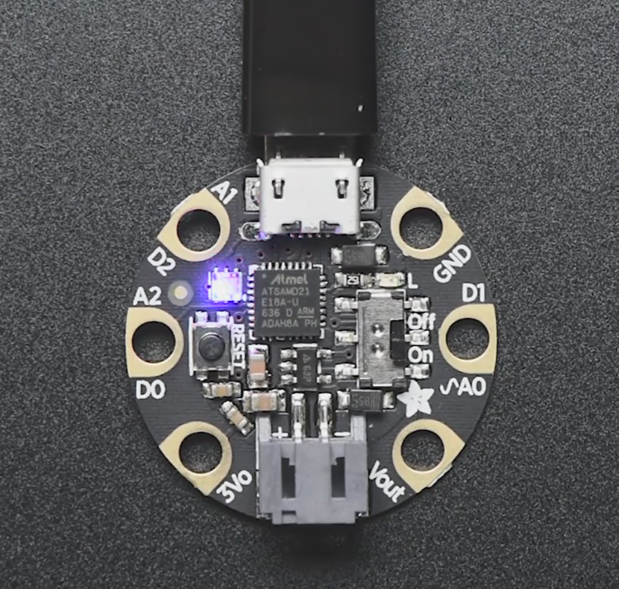
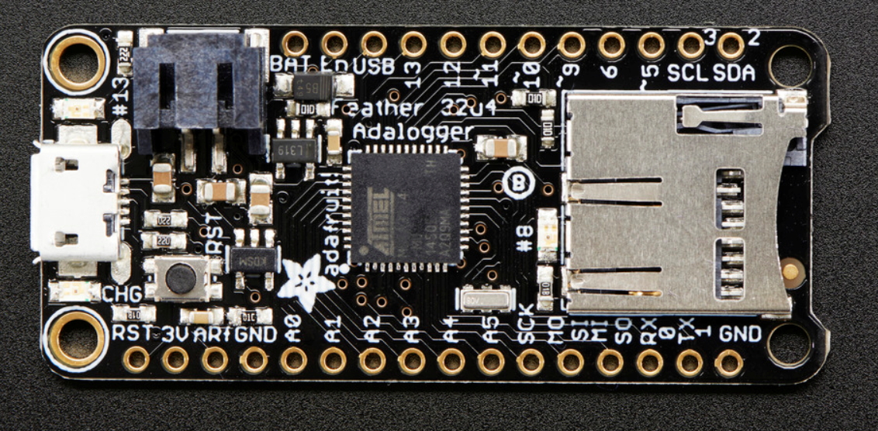
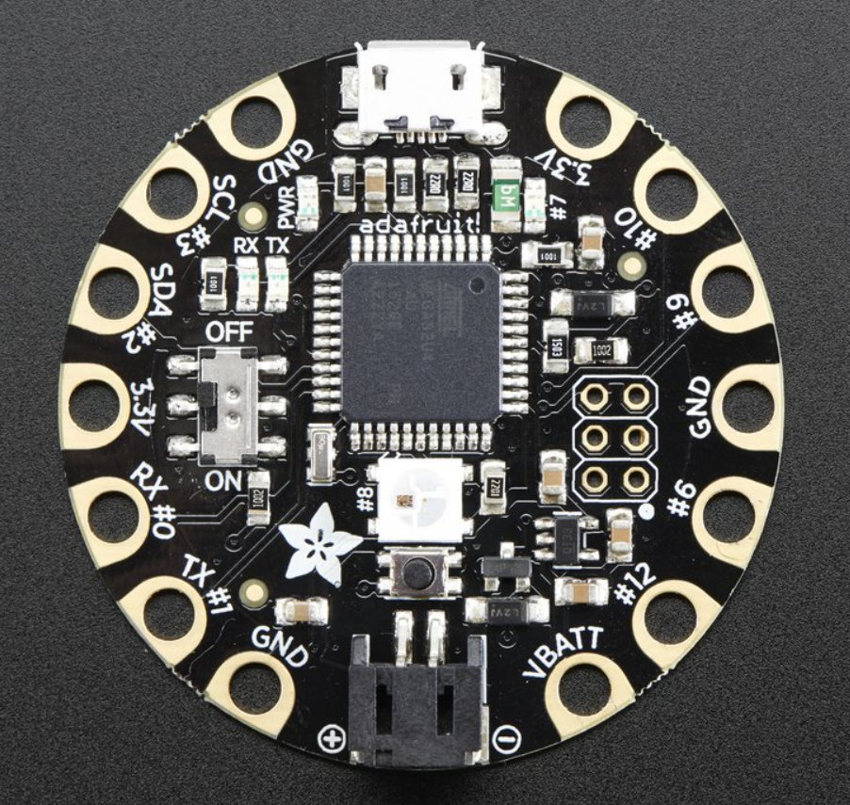
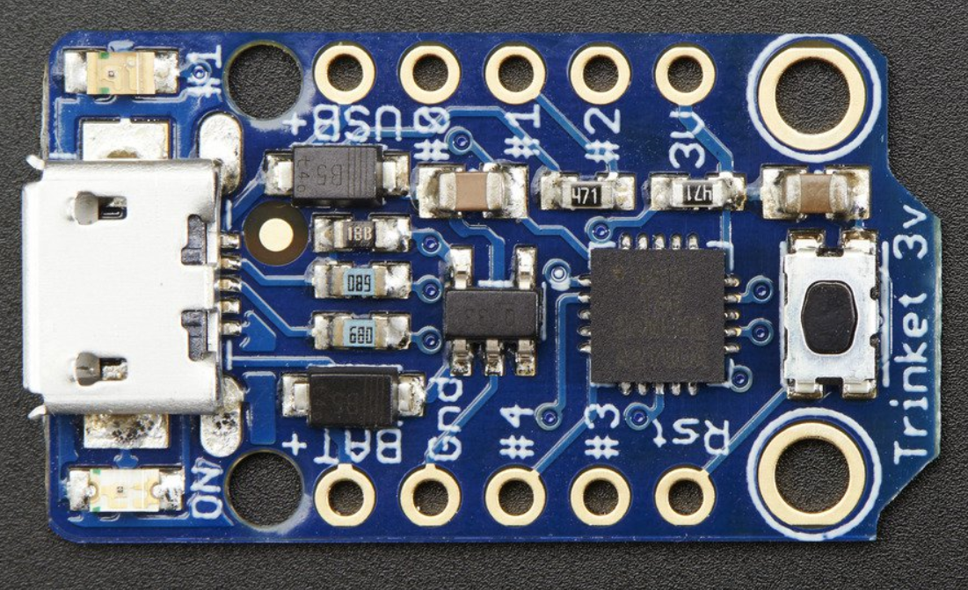
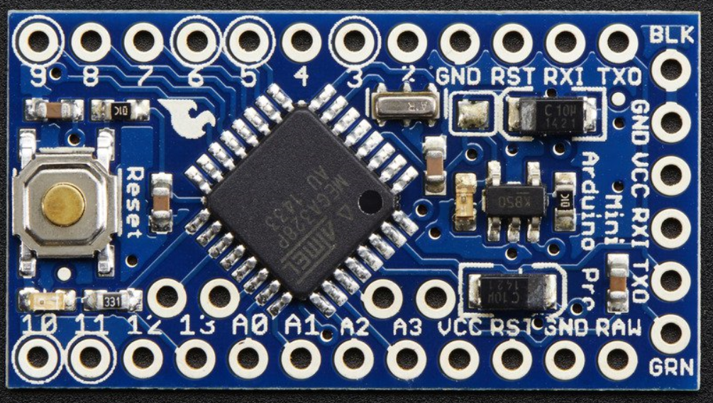
Non-Standard Arduino Boards
Adafruit Gemma
Adafruit Feather
Adafruit Circuit Playground
Adafruit Trinket
Arduino Mini
Adafruit Flora
From www.Adafruit.com

Slide 22
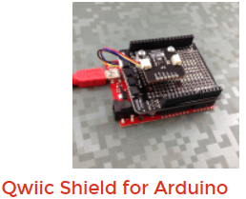
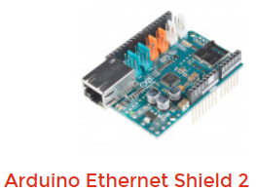
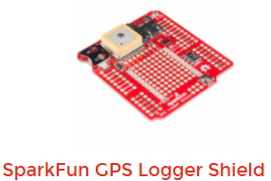
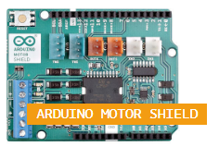
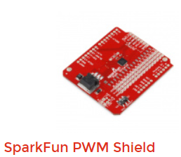

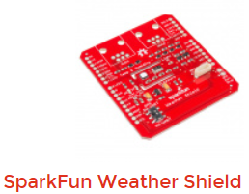
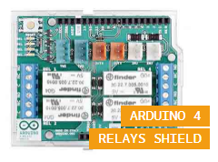
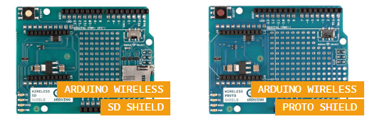
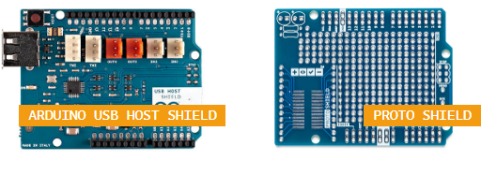
Arduino Shields

Slide 23
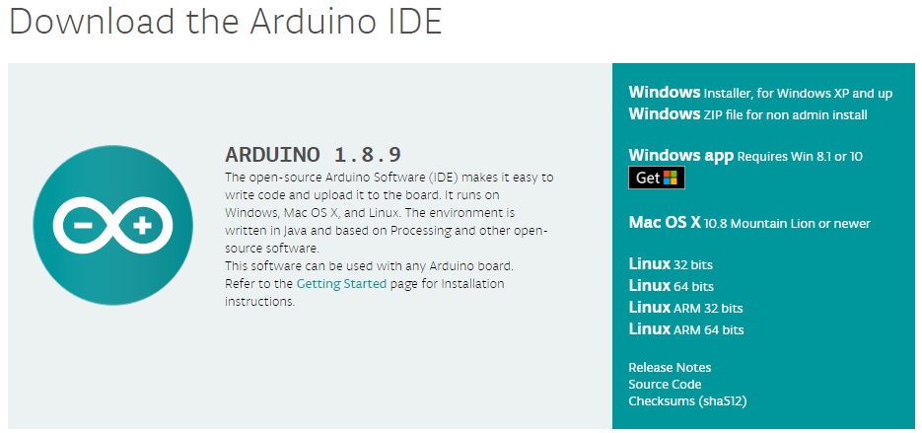
How to get started. – Arduino.cc

Slide 24
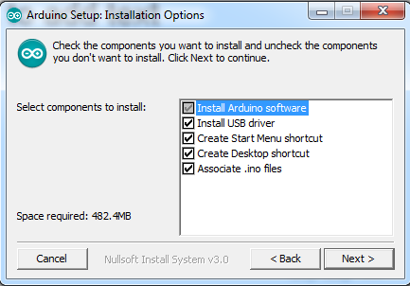
Install the Software with Drivers

Slide 25
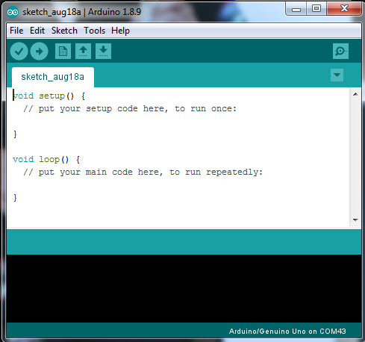

Slide 26
Hello World – Blink LED
Open a new Sketch, and enter the following:
int D13 = 13;
void setup() {
// put your setup code here, to run once:
pinMode(D13, OUTPUT);
}
void loop() {
// put your main code here, to run repeatedly:
digitalWrite(D13, HIGH);
delay(1000);
digitalWrite(D13, LOW);
delay(1000);
}

Slide 27
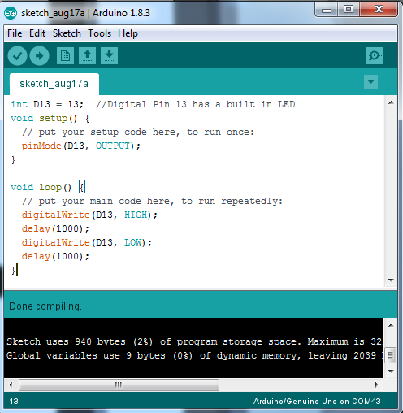
Click Verify and make sure it compiles

Slide 28
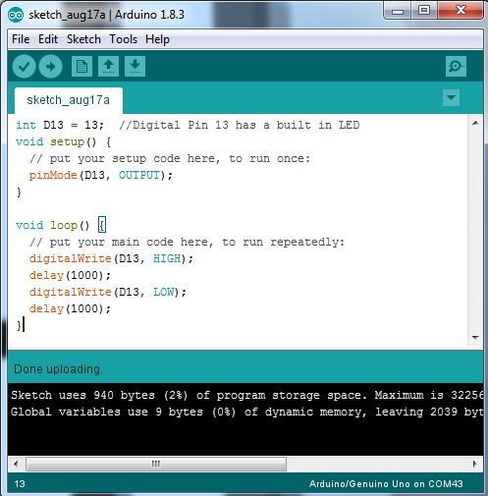
Upload to the Arduino

Slide 29
On to Arduino Uno
Unplug Adafruit Circuit Playground.
Plug in Arduino Uno or SparkFun “RedBoard”.
Set the board and port.
Open the Adafruit_CCS811 -> CCS811_test
Connect up the I2C CCS811
3.3V to 3.3V, GND to GND, SCL to SCL, and SCA to SCA
Compile and down load the code
Open serial monitor. Watch for more than 60 seconds.
Breathe on sensor.

Slide 30
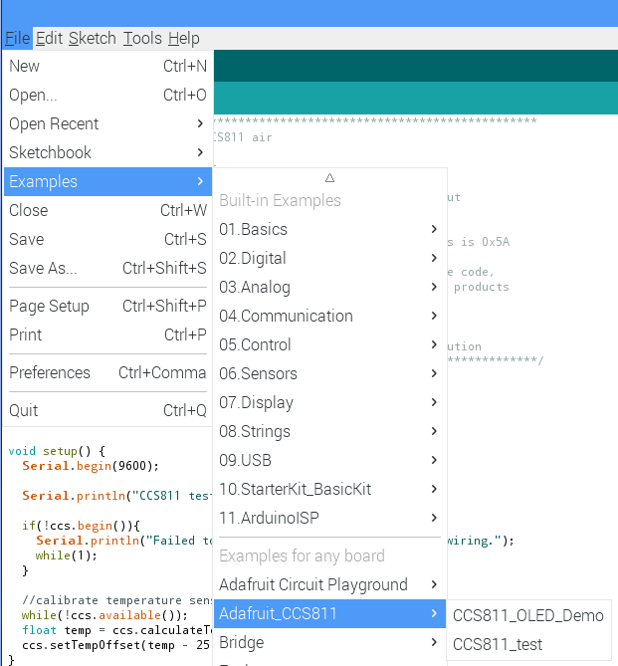
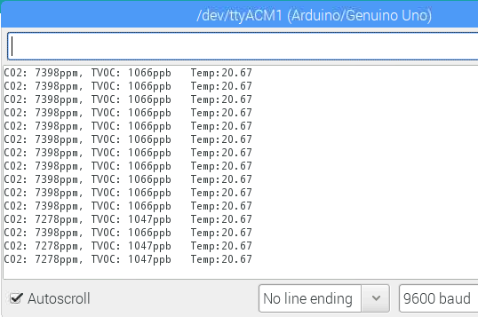
The IDE Selection and Example Output

Slide 31
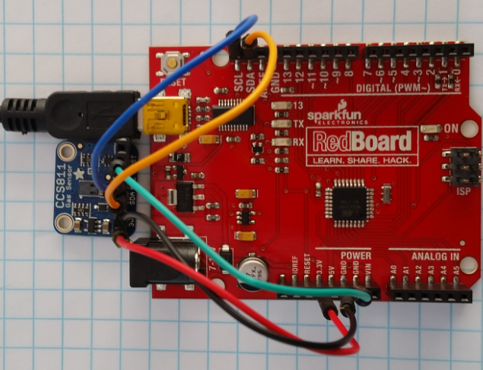
CCS811 Hookup

Slide 32
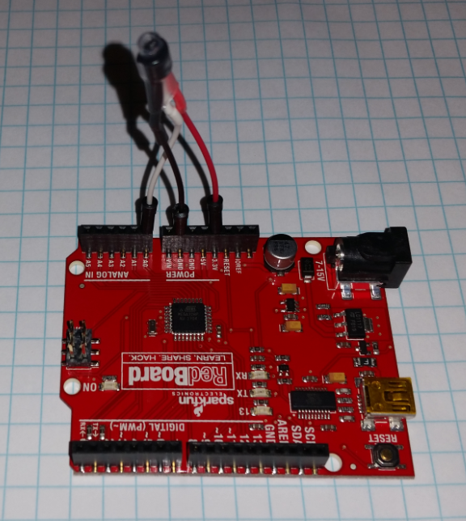
Arduino Code from Scratch
Remove existing circuit.
Add on the TMP 36 thermal sensor. Red - +3.3V, Black - GND, White - A0
Open AnalogInSerialOut example.
Change code to output ‘F and ‘C
TMP36 voltage = 500mV + 10mV*’C
10 bit ADC (1024 steps) 5.0V full scale.
‘F = ‘C*5/9 + 32
Compile and download code.
Open serial monitor.

Slide 33
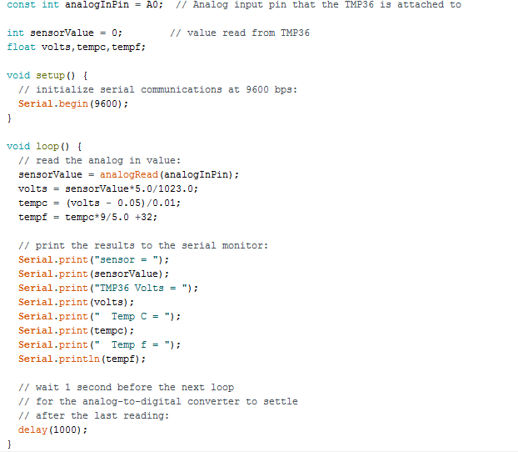
Convert the example to the following

Slide 34
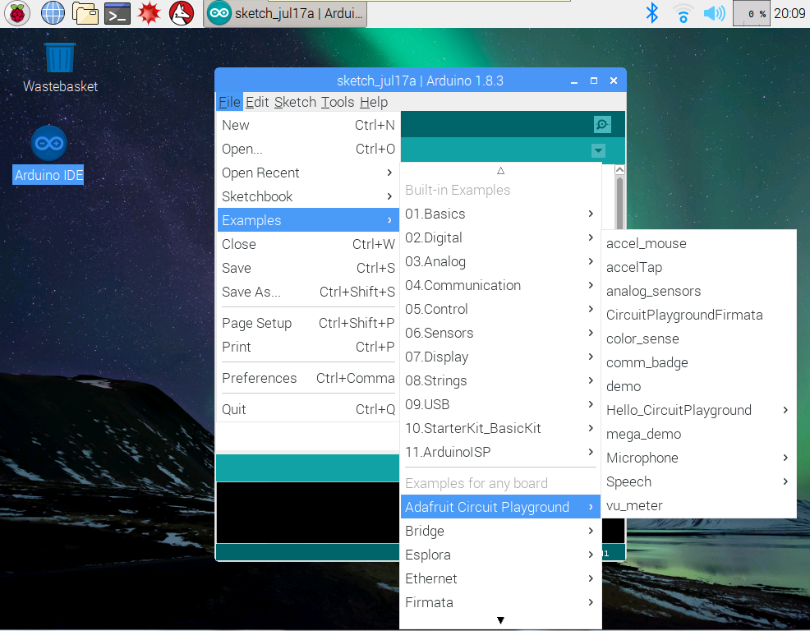
Switching Boards To Circuit Playground

Slide 35
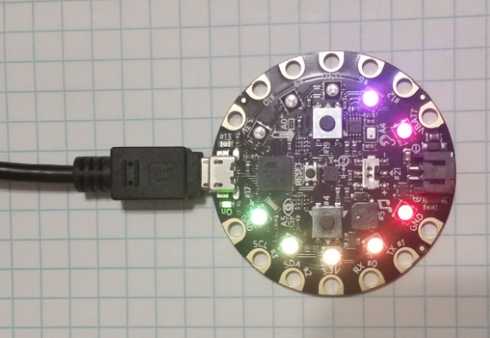
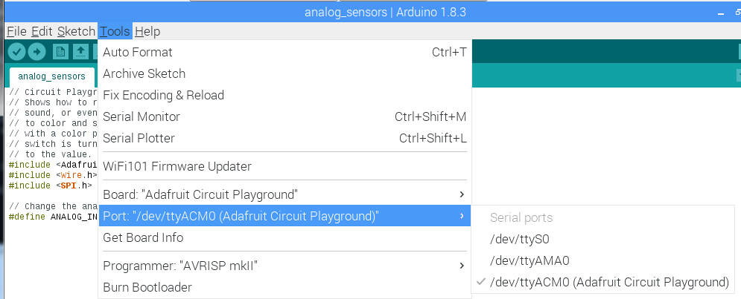
Connect to board Make sure it is Adafruit Circuit Playground

Slide 36
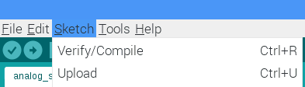
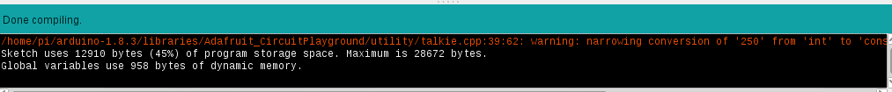
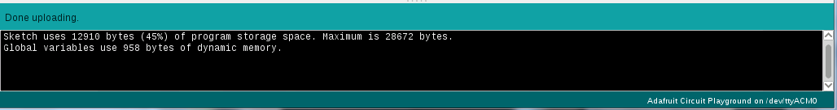
Verify Compile and Upload

Slide 37
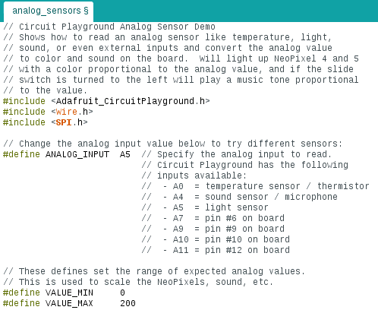

Try Changing the Sensor from Light to Sound

Slide 38
Try Other Example Programs
VuMeter - Nice light display of sound volume to the microphone.
Color Sensor – Can tell what Color it is seeing.
Speech – Hear a small voice vocabulary, change what it says.
Accel-mouse – Turn the Circuit Playground into a tilt-controlled mouse.

